Slide 1
Hyperonomy Universal Decentralized Identifier URI Specification (did-uri-spec) https://github.com/mwherman2000/did-uri-spec
v0.21
Michael Herman (@mwherman2000)
Independent Blockchain Architect
mwherman@parallelspace.net

Slide 2

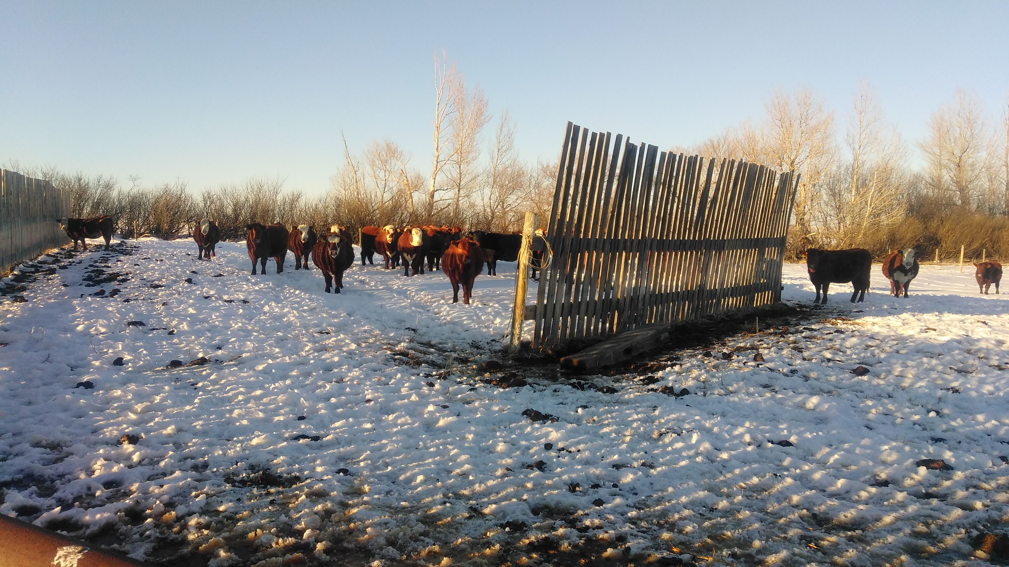
Michael Herman Independent Blockchain Architect Alberta, CANADA

Slide 3
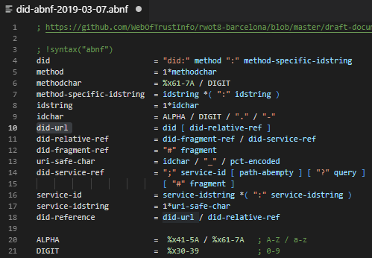
did-url renamed to did-uri Everywhere
Hyperonomy Universal Decentralized Identifier URI Specification (did-uri-spec)
https://github.com/mwherman2000/did-uri-spec
At the most basic level, a did-uri is an identifier, a unique specification, for what instance of a document (aka resource) is to be returned.
Further, there are many types of documents that can be returned as shown on slides 45-46.
"DID ABNF (BB)" (Before Barcelona)
https://github.com/mwherman2000/did-uri-spec/blob/master/abnf/did-abnf-2019-03-07.abnf/

Slide 4
High-level did-uri User Scenarios (Slide 45)
# | did-uri Syntax Patterns | Type of Document Returned
1 | <did> | DID Document
2 | <did>!$selectId="exam_src" | DID Document Fragment
3 | <did>!$serviceId="exam_src" | Remapped Service Endpoint URI/URL
4 | <did>!$contentId="pqrs" | DID Doc Content Fragment
5* | <did>!$attachmentId="abcd" | A2A Message Attachment Fragment
6 | "query": "<did>!$filter='*'" | Array of All Service Agent Feature/Protocol Descriptions
7 | "query": "<did>!$filter='spec/tictactoe/1.*'" | Array of Filtered Service Agent Feature/Protocol Descriptions
8 | <didmethod>!$supportedCapabilities | Array of DID Method Capabilities
9a | did:!$documents / did:xyz:!$documents | Array of DID Documents
9b | did:xyz:!$documents&$top=10&$skip=100 | Batch of DID Documents
9c | did:xyz:!$documents&$filter='has=ServiceEndPoint'&$top=10&$skip=100
9d | did:xyz:!$documents&$filter='version=4'&$top=10&$skip=100
Notes:
* Makes false assumption that each Agent message has a `did` associated with it.

Slide 5
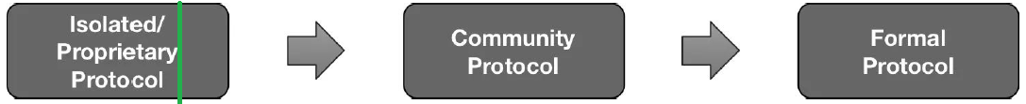
Status
The status of this specification is that it is a work-in-progress community member contribution.
The current intention is for this specification to be merged into the W3C Decentralized Identifiers, DID Resolution, and related specifications (e.g. Indy HIPEs) directly, by reference, or as an appendix.

Slide 6
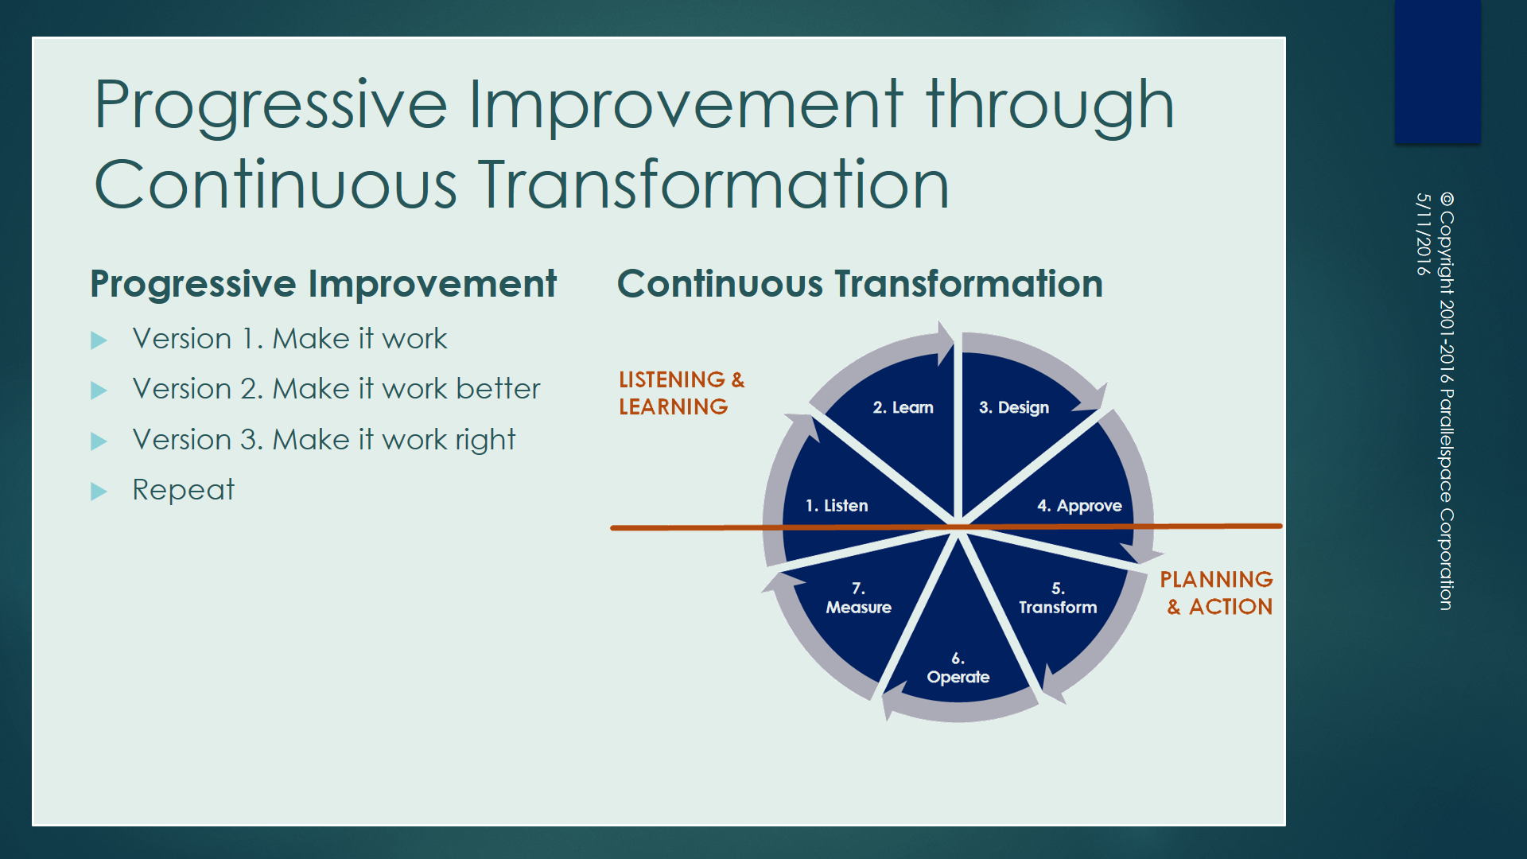
How we think about how we work
https://hyperonomy.com/2016/05/09/how-do-we-think-about-how-we-work/

Slide 7
Purpose and Audience
Purpose
The purpose of this specification is to document the development of as well as the final version of the did-uri grammar for the Hyperonomy Universal Decentralized Identifier URI Specification (did-uri-spec).
Audience
The primary audience for this specification is implementors and maintainers of parser software that is compliant with the did-uri-spec including but not limited to:
W3C Decentralized Identifier specification
DID Resolvers and DID Resolution
Agent-to-Agent (A2A) Communications services in the Hyperledger Indy Agent framework

Slide 8
Goals and Non-goals
Goals
Document the development of the did-uri-spec version of the did-uri grammar
Publish the final version of the did-uri grammar
Non-goals
It is not a goal of this discussion force any particular project or specification effort to adopt this specification but it is hoped that this specification significantly influences the current state and all future states of the did-uri grammar discussions.

Slide 9
Universal Decentralized Identifier URI Specification User Scenarios / Applications
W3C Decentralized Identifiers specification
DID Resolvers and DID Resolution specification
Indy HIPES including
Agent-to-Agent (A2) Communications service
Attachments
Feature discovery
Others?
NOTE
This document is a specification specifically for Universal Decentralized Identifier URIs ...described by the did-uri grammar using the ABNF notation.
For a better understanding of this terminology, read: Giving Grammars Written with ABNF Notation the Respect They Deserve (https://hyperonomy.com/2019/03/11/giving-grammars-written-with-abnf-notation-the-respect-they-deserve/).

Slide 10
Motivation
During the Feb. 21, 2019 DID Resolution community call, there was a early/initial discussion about using an HTTP binding pattern such as:
http://uniresolver.io/resolve/did:xyz:1234
http://uniresolver.io/dereference/did:xyz:1234#key1
It was surprising to see the above pattern being proposed because the resolve and dereference operations are redundant.
I assume that the purpose of the current "DID ABNF" syntax discussions is to encapsulate these types of operations into a did-uri grammar. Based on this assumption, the following did-uri patterns (and HTTP bindings) are being recommended for use as the primary patterns for the previous 2 use cases:
Resolution: http://uniresolver.io/did:xyz:1234
Dereferencing (general case): http://uniresolver.io/did:xyz:1234#key1 and, optionally, http://uniresolver.io/did:xyz:1234!$selectId="key1"

Slide 11
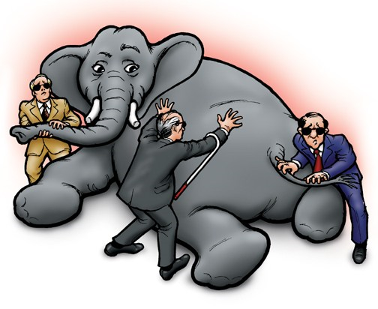
Motivations For a More Refined Approach
did-uri Grammar
DID Resolution
RFC3986
DID Spec
DID ABNF
Indy
HIPES
"naked"
DID
IPID
Blind Men and the Elephant Problem
https://en.wikipedia.org/wiki/Blind_men_and_an_elephant

Slide 12
Universal Decentralized Identifier URI Specification User Scenarios / Applications
did-spec Specification
Universal
did-uri
Grammar & Specification
did-resolution
Specification
Indy HIPEs
…

Slide 13
Universal Decentralized Identifier URI Specification User Scenarios / Applications
did-spec Specification
Universal
did-uri
Grammar & Specification
did-resolution
Specification
Indy HIPEs
…
DID Resolver
Indy Agent Framework
Universal
did-uri
Parser (Java/C++/C#)
Indy Agent-to-Agent Communications
…

Slide 14
Approach
The general approach is:
Use the original architectural principles from the draft did-spec as well as the higher-level DID user scenarios from several documents (see below) to create a comprehensive list of lower-level did-uri use cases for the did-uri grammar.
Use the lower-level did-uri use cases which in turn can drive the design of the did-uri grammar (expressed at a higher level using ABNF notation).
Use the did-uri grammar design to drive the implementation (i.e. ABNF source code) for the actual did-uri grammar.
Validate the did-uri grammar by testing using test cases based on the did-uri lower-level use cases.
Iterate.

Slide 15
Guiding Principles (1/2)
Follow the Core Principles expressed in the following documents:
The #OpenToInnovation Principle: Internet protocols and standards not only need to be open, but more importantly, open to innovation (https://hyperonomy.com/2019/03/12/internet-protocols-and-standards-not-only-need-to-be-open-but-more-importantly-open-to-innovation/)
Giving Grammars Written with ABNF Notation the Respect They Deserve (https://hyperonomy.com/2019/03/11/giving-grammars-written-with-abnf-notation-the-respect-they-deserve/)
Ensure that an app developer has the tools he/she needs to be able to effectively search, find, resolve, and dereference:
Single DID Document associated with a DID, or
Collection of DID Documents based on several criteria (defined in the use cases)
Ensure that an app developer has the tools he/she needs to be able to effectively search, find, resolve, dereference, and execute:
Service endpoint associated with a service-id in a single DID Document associated with a DID.

Slide 16
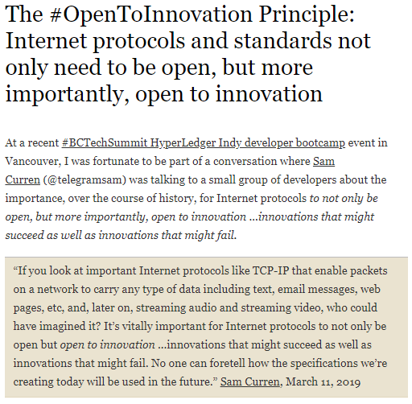
#1.1

Slide 17
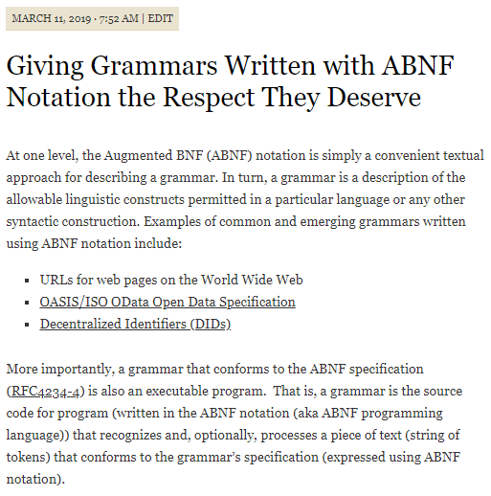
#1.2 (1/3)

Slide 18
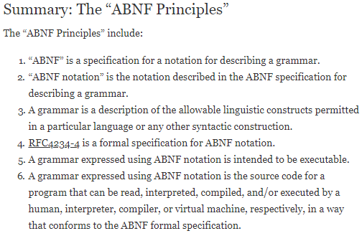
#1.2 (2/3)

Slide 19
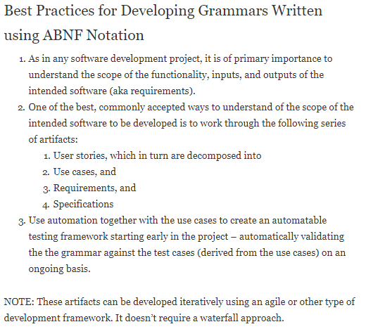
#1.2 (3/3)

Slide 20
Guiding Principles (2/2)
Ensure that the above operations and capabilities are expressed in a consistent did-uri syntax - eliminating the need for creating additional language and/or API constructs, wherever possible.
Ensure that the draft "DID ABNF" supports the above goals and doesn't unnecessarily restrict future innovation with respect to did-uri parsing (and DID Resolution, specifically but not exclusively) ...that is, that the "DID ABNF" doesn't restrict the syntax patterns needed for present and future did-uri parsing (and DID Resolution, specifically but not exclusively) innovation. This is especially important because the current "DID ABNF" is completely defined in a different specification from the DID Resolution specification (i.e. the DID Specification).
Ensure that an app developer has the tools he/she has the basic operational capabilities available to test if a DID Resolver is alive and responsive, control the format of the DID Resolver response, etc.
The lower-level did-uri use cases will be guided/driven by the specific higher-level DID user scenarios documents listed below. See Principle 1.2 above.
Compliant with RFC 3986 Uniform Resource Identifier (URI): Generic Syntax (https://tools.ietf.org/html/rfc3986).

Slide 21
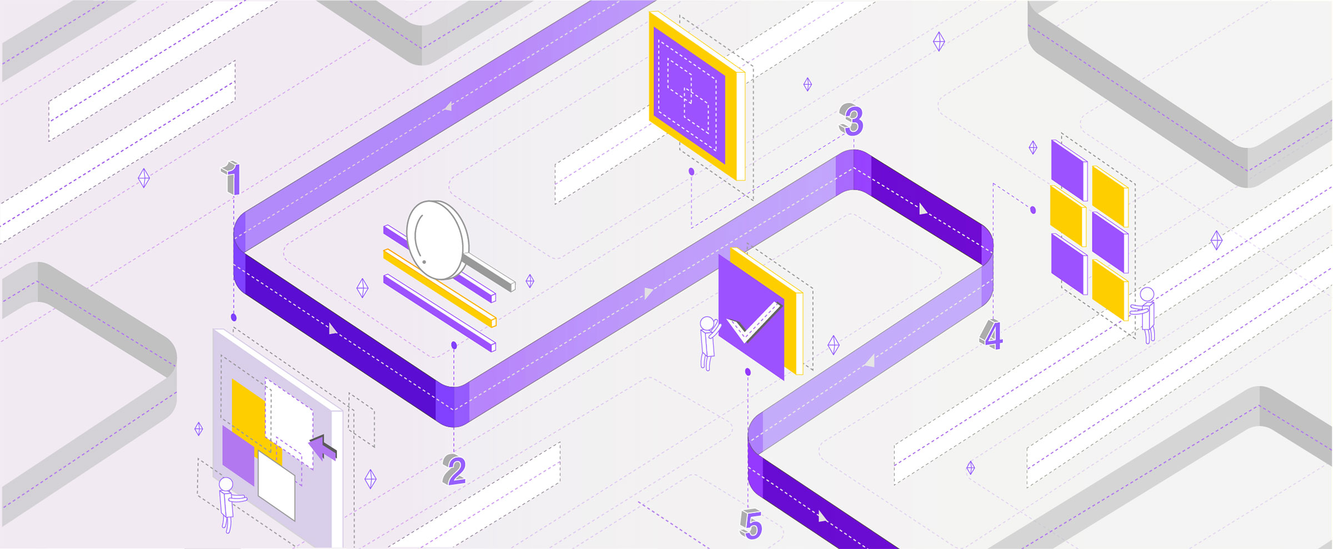
 Background
Michael Herman (@mwherman2000)
Independent Blockchain Architect
mwherman@parallelspace.net
2019-04-01

Slide 22
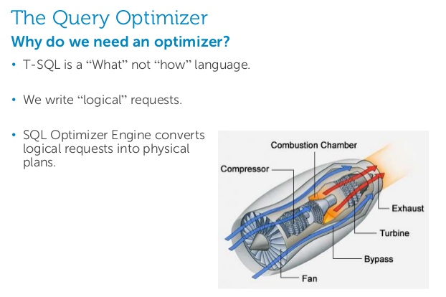
Generic Parsing and Processing (1/3)
Declarative language – not a Functional language

Slide 23
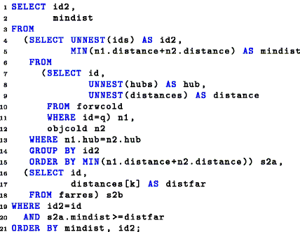
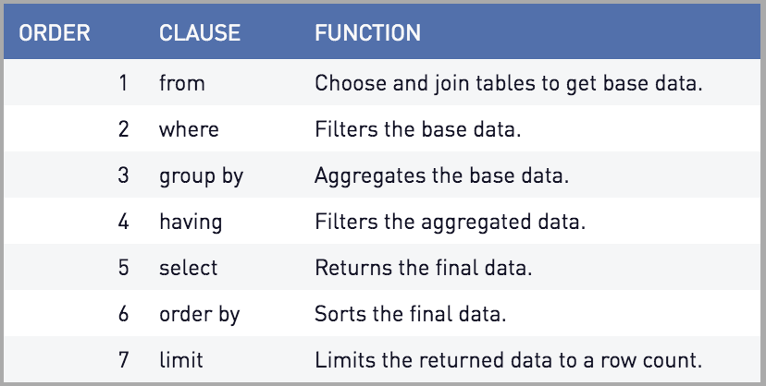
Generic Parsing and Processing: SQL Example
T-SQL is a Declarative language – it describes what is to be returned
T-SQL is not a Functional language – it doesn’t describe how to access or how to enumerate over the data store
Clause Ordering is Declarative – not Functional

Slide 24
Generic Parsing and Processing (1/2) Sample User Scenarios
T-SQL Query
Parser
Analyser
Optimizer (RDB)
Execution Engine (RDB)
Relational Datastore
Cypher Query
Parser
Analyser
Optimizer (NGDB)
Execution Engine (NGDB)
Neo4j Graph DB
No-SQL Query
Parser
Analyser
Optimizer (NSDB)
Execution Engine (NSDB)
No-SQL Datastore

Slide 25
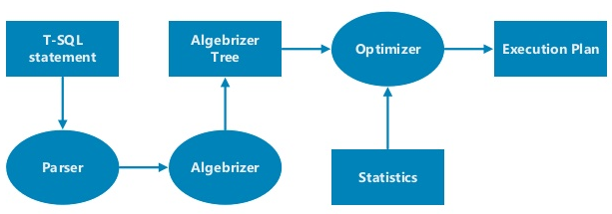
Generic Parsing and Processing Pipeline
Parsing
Processing
Semantic Analysis
Optimization
Execution
T-SQL
Statement
7
did-uri
1
Cypher
Statement
4
5
Hard Parse
2
3
6
Soft Parse

Slide 26
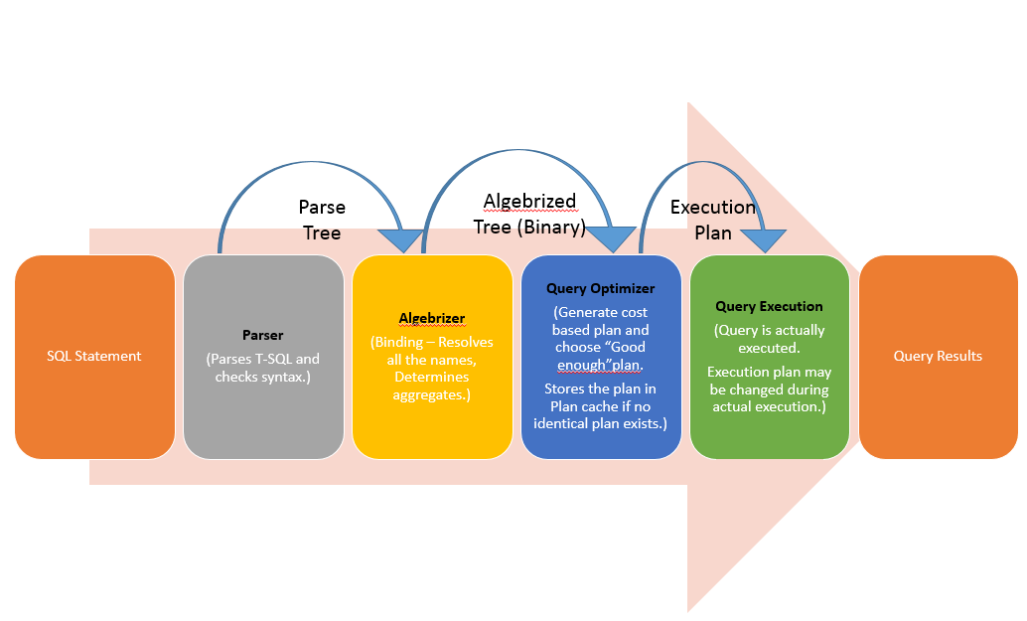
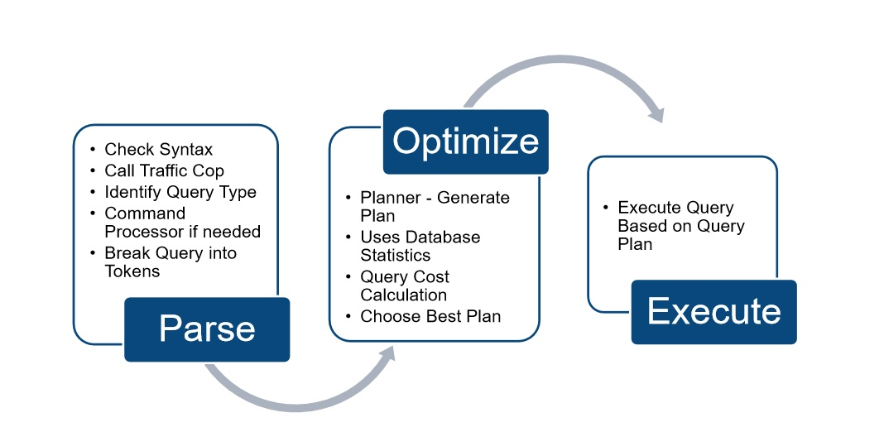
SQL Server Query Execution Flow (T-SQL Query)

Slide 27
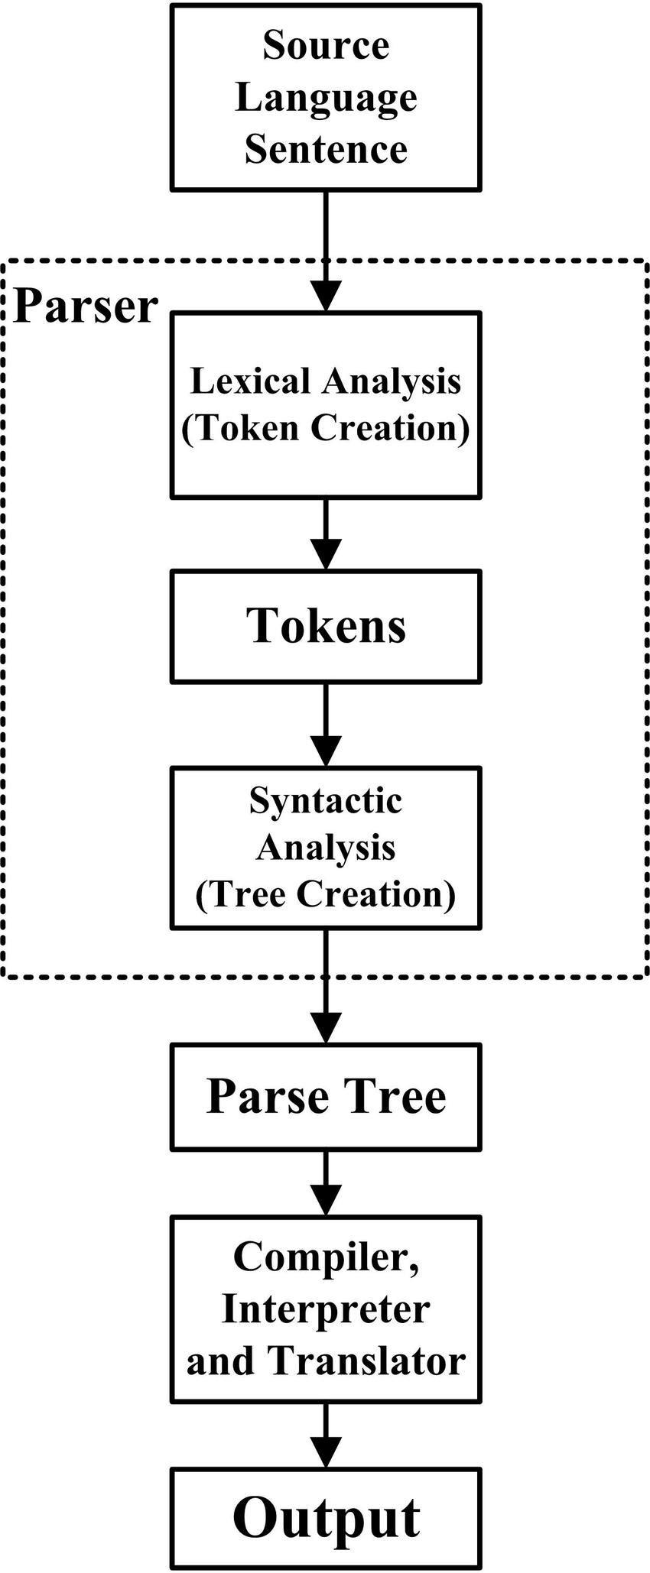
Parsing: Soft Parse vs. Hard Parse
A Soft Parse is when a did-uri is comprised of a did only (with no additional grammar rules (features) specified)
Only physical access optimizations are possible
A Hard Parse is when a did-uri is comprised of a did plus additional grammar rules (features)
Additional types of optimizations are possible (e.g. $exist)
Soft
Parse
Hard Parse

Slide 28
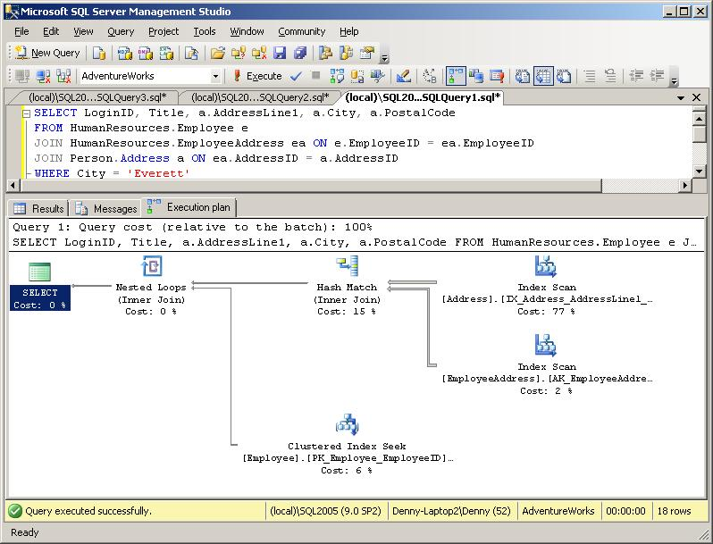
Processing: Execution Plans (T-SQL)

Slide 29
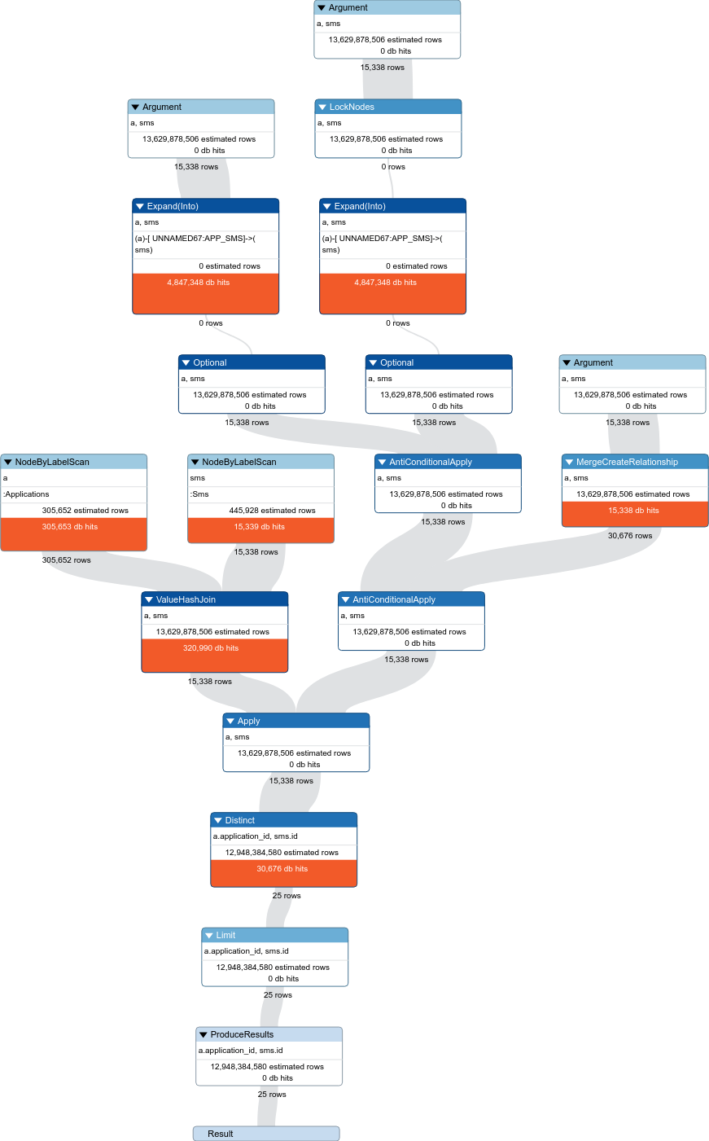
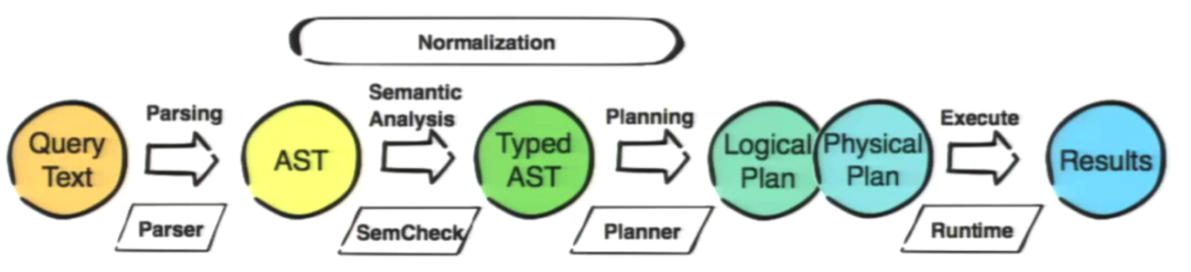
Processing: Execution Plans (Cypher/Neo4J) Neo4j Graph Database
MATCH (a:Applications), (sms:Sms {id: a.application_id})
MERGE (a)-[r:APP_SMS]->(sms)
RETURN distinct a.application_id, sms.id
I have executed the same query with profile and limit 25 to see the query plan and results:
10382692 total db hits in 3219 ms
Credit: https://stackoverflow.com/questions/52465038/merge-query-optimization-neo4j?rq=1

Slide 30
 did-uri Parsing and Processing
Michael Herman (@mwherman2000)
Independent Blockchain Architect
mwherman@parallelspace.net
2019-04-01

Slide 31
Generic Parsing and Processing (1/2) Sample User Scenarios
T-SQL Query
Parser
Analyser
Optimizer (RDB)
Execution Engine (RDB)
Relational Datastore
Cypher Query
Parser
Analyser
Optimizer (NGDB)
Execution Engine (NGDB)
Neo4j Graph DB
No-SQL Query
Parser
Analyser
Optimizer (NSDB)
Execution Engine (NSDB)
No-SQL Datastore

Slide 32
Generic Parsing and Processing (repeat)
Declarative language – not a Functional language

Slide 33
Generic Parsing and Processing (2/2) did-uri Scenarios
did-uri
Parser
Analyser
Optimizer (VDR)
Execution Engine (VDR)
Verifiable Data Registry
did-uri
Parser
Analyser
Optimizer (AFDB)
Execution Engine (AFDB)
Indy Agent Feature DB
did-uri*
Parser
Analyser
Optimizer (JSON)
Execution Engine (JSON)
Indy Agent
Message Attachment
Collection
did-uri
-
-
-
-
id
Attribute

Slide 34
DID Dereferencing DOES NOT Require DID Resolution
In a recent DID Resolution community discussions (March 2019), DID Dereferencing of a did-uri as process that starts with/requires the resolution of the DID Document associated with the did-uri and then continues with the dereferencing against the associated DID Document
While it might be true at a very conceptual level for some DID Methods and their corresponding Verifiable Data Registries (VDRs), as a generalization, it’s not true.
did-uri’s are expressions similar to any expressions sent through a Parsing and Processing pipeline
did-uri’s are logical expressions of describing what is to be returned (in the spirit of RFC3986)
The form, function, and intention of a did-uri is to describe what is to be returned; not how it is to be returned.

Slide 35
 An Example
Michael Herman (@mwherman2000)
Independent Blockchain Architect
mwherman@parallelspace.net
2019-04-01

Slide 36
did-uri Service Endpoint Transformers: Use Cases
H. DID URI Service Endpoint Transformation Use Cases
using "!" transformer (pipe) option and $serviceId transform option
The following use cases use the "!" transformer (pipe) option and $serviceId transformer (pipe) option (aka $serviceId transformer).
The tokens immediately precede "!" is formally the text that matches be the did rule. The semantics are:
Take the did text (up to the "!" pipe option), and
Pass it through a transformation represented by the transform options that follow the "!" transformer (pipe) option.
For example, if the transformer is $serviceId="<service-id>", the effect is to produce the resolved URL/URI for, the service endpoint corresponding service-id. Conceptually, the processing is: did | transform(tranformOptions) to produce a transformed-uri

Slide 37
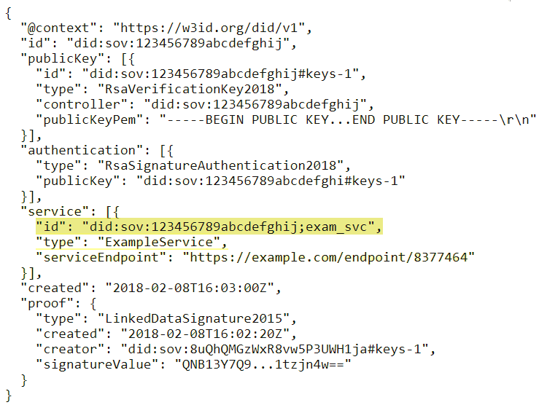
did-uri Service Endpoint Transformers: Examples

Slide 38
did-uri Service Endpoint Transformers: Examples
Here's are 2 specific examples based on the Windley examples. These examples also make clear the difference between the transformer approach and the ';' approach. The subject DID document is from Windley article.
Approach Example
Windley did:sov:123456789abcdefghij;exam_svc
Transformer did:sov:123456789abcdefghij!$serviceId="exam_svc"
Both of the above did-uri’s resolve (dereference) to the same URI/URL: https://example.com/endpoint/8377464
Approach Example
Windley did:sov:123456789abcdefghij;exam_svc/foo/bar?a=1#flip
Transformer did:sov:123456789abcdefghij!$serviceId="exam_svc"/foo/bar?a=1#flip
Both of the above did-uri’s resolve (dereference) to the same URI/URL: https://example.com/endpoint/8377464/foo/bar?a=1#flip

Slide 39
did-uri Service Endpoint Transformers: NOTES
NOTE: DID schemes and/or DID Resolvers can define additional transform options. They are not limited by the syntax specification.
NOTE: The ";" token is no longer used anywhere in DID syntax patterns represented across all of the use case categories.
NOTE: Related (and reflecting the views of @dhh128 in comment https://github.com/w3c-ccg/did-spec/pull/168#issuecomment-471655338), there should no longer be a need to use ";' or any special symbol (other than "#") in the id attribute of a service endpoint in a DID Document.

Slide 40
 Use Case Analysis
Michael Herman (@mwherman2000)
Independent Blockchain Architect
mwherman@parallelspace.net
2019-04-01

Slide 41
Use Case Analysis
Higher-level DID user scenarios guide/drive the development of the lower-level did-uri use cases
Higher-level DID User Scenario Analysis
DID User scenarios
High-level did-uri User Scenario Analysis
did-uri user scenario
Lower-level did-uri Use Case Analysis
did-uri use cases

Slide 42
 Higher-Level DID User Scenarios
Michael Herman (@mwherman2000)
Independent Blockchain Architect
mwherman@parallelspace.net
2019-04-01

Slide 43
Higher-Level DID User Scenarios
The following higher-level DID user scenario documents that have been selected to guide/drive the lower-level did-uri use cases:
Use Cases for Decentralized Identifiers
https://w3c-ccg.github.io/did-use-cases/
Universal DID Operations
https://github.com/WebOfTrustInfo/rwot8-barcelona/blob/master/topics-and-advance-readings/Universal-DID-Operations.md
Indy draft feature-discovery 1.0 HIPE
https://github.com/dhh1128/indy-hipe/blob/9c7722d208cfe0a336cb67a626cbbb192ae73f8c/text/feature-discovery/README.md
Indy draft attachments HIPE
https://github.com/hyperledger/indy-hipe/blob/bd48bae3712e659c34d88c6dea839ccf5a0f0701/text/attachments/README.md

Slide 44
 High-Level did-uri User Scenarios
Michael Herman (@mwherman2000)
Independent Blockchain Architect
mwherman@parallelspace.net
2019-04-01

Slide 45
High-level did-uri-spec User Scenarios (Slide 45)
# | did-uri-spec Syntax Patterns | Type of Document Returned
1 | <did> | DID Document
2 | <did>!$selectId="exam_src" | DID Document Fragment
3 | <did>!$serviceId="exam_src" | Remapped Service Endpoint URI/URL
4 | <did>!$contentId="pqrs" | DID Doc Content Fragment
5* | <did>!$attachmentId="abcd" | A2A Message Attachment Fragment
6 | "query": "<did>!$filter='*'" | Array of All Service Agent Feature/Protocol Descriptions
7 | "query": "<did>!$filter='spec/tictactoe/1.*'" | Array of Filtered Service Agent Feature/Protocol Descriptions
8 | <didmethod>!$supportedCapabilities | Array of DID Method Capabilities
9a | did:!$documents / did:xyz:!$documents | Array of DID Documents
9b | did:xyz:!$documents&$top=10&$skip=100 | Batch of DID Documents
9c | did:xyz:!$documents&$filter='has=ServiceEndPoint'&$top=10&$skip=100
9d | did:xyz:!$documents&$filter='version=4'&$top=10&$skip=100
Notes:
* Makes false assumption that each Agent message has a `did` associated with it.

Slide 46
High-level did-uri-spec User Scenarios (Slide 46)
# | did-uri Syntax Patterns | Type of Document Returned
10 | <did>!?$exists | True or False
11 | <did>!?$exists="bops" | True or False
12 | <did>!$type="diddoc" (default type – UC #1) | DID Document
13 | <did>!$type="schema" | Schema Document
14 | <did>!$type="creddef" | Credential Definition Document
15 | <did>!$type="overlay.format" | Format Overlay Document
16 | <did>!$type="node" | VDR Node Document
17 | did:!$type="config.pool" | Pool Configuration Document
18 | did:!$type="perfmon.pool" | Pool Performance Monitoring Doc
19 | did:xyz:!$type="perfmon.didmethod" | DID Method Perf. Monitoring Doc

Slide 47
 Lower-Level did-uri Use Cases
Michael Herman (@mwherman2000)
Independent Blockchain Architect
mwherman@parallelspace.net
2019-04-01

Slide 48
DID Document Examples
DID Spec - Example 16
INDY-ARM Example
Windley Article Example

Slide 49

Lower-Level did-uri Use Cases: A
RFC 3986
Compliant

Slide 50
Lower-Level did-uri Use Cases: B (superseded by H)

Slide 51
Lower-Level did-uri Use Cases: C
RFC 3986
Compliant

Slide 52
RFC 3986
Compliant

Slide 53
Lower-Level did-uri Use Cases: E
RFC 3986
Compliant

Slide 54
Lower-Level did-uri Use Cases: F
RFC 3986
Compliant

Slide 55
Lower-Level did-uri Use Cases: G
RFC 3986
Compliant

Slide 56
Lower-Level did-uri Use Cases: H
RFC 3986
Compliant

Slide 57
Lower-Level did-uri Use Cases: I
RFC 3986
Compliant

Slide 58
Lower-Level did-uri Use Cases: J
RFC 3986
Compliant

Slide 59
Lower-Level did-uri Use Cases: J
RFC 3986
Compliant

Slide 60
Lower-Level did-uri Use Cases: K
RFC 3986
Compliant

Slide 61
Lower-Level did-uri Use Cases: L
RFC 3986
Compliant

Slide 62
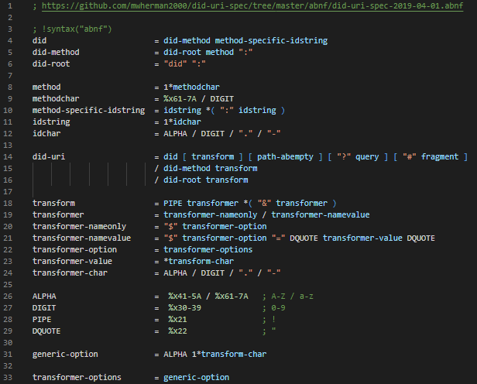
Generic/ Baseline did-uri-spec Grammar

Slide 63
 Tooling
Michael Herman (@mwherman2000)
Independent Blockchain Architect
mwherman@parallelspace.net
2019-04-01

Slide 64
Grammar-Based Automated Parser Generation
aparse parser generator (http://www.parse2.com)
parse2 produces the aParse parser generator that reads Augmented BNF grammars and produces Java, C++ or C# classes that can build parse trees for valid instances of those grammars. aParse is free to download and use without any obligations or limitations.
Using an aParse generated parser, a Java, C++ or C# program can confirm whether a stream of characters represents a valid instance of a particular grammar, for example, a message passed between two programs that should comply with an agreed protocol. The parse tree of a compliant message can be used by the program to process the message content (see the examples for a number of working programs that employ aParse generated parsers).

Slide 65
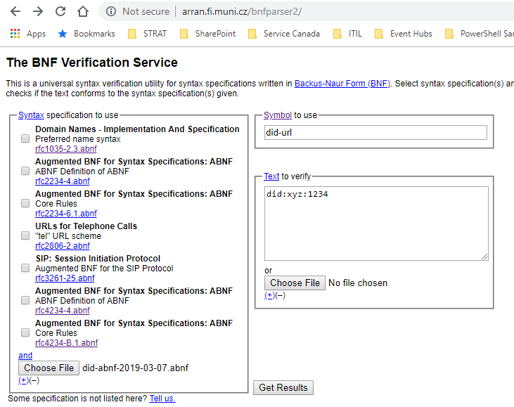
Grammar Testing / Validation
did-uri Grammar Validation Tool (Web)
The following web app is being used to validate the did-uri grammar against the lower-level use cases: The BNF Verification Service (http://arran.fi.muni.cz/bnfparser2/)

Slide 66
Implications
Impact on DID Document Grammar
";" is no longer needed/used in a DID Document
From a syntactical perspective, all "anchors" / "selection IDs" are prefixed with a '#' only.
The semantic meaning is determined by the referring did-uri transformer.
Impact on Other Specifications
Hyperledger Indy HIPEs
Feature discovery "filter" operator
Attachments id attributes
Others?

Slide 67
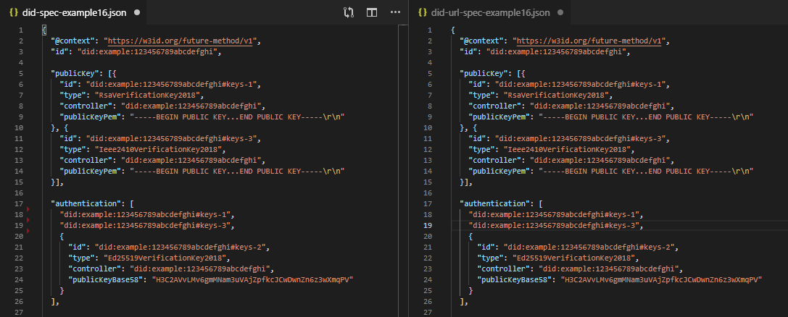
Example 16

Slide 68
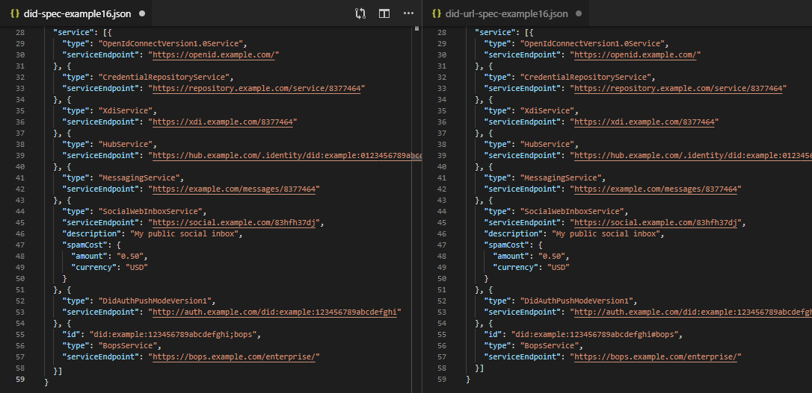
Example 16

Slide 69
 Wrapping UP…
Michael Herman (@mwherman2000)
Independent Blockchain Architect
mwherman@parallelspace.net
2019-04-01

Slide 70
Next Steps
Continue to grow and validate the number of higher-level DID user scenarios and, more specifically, lower-level did-uri use cases with:
Diverse DID communities
Diverse DID higher-level DID user scenarios
More Indy HIPES
IPID, etc.
Build and test did-uri grammar
Using the lower-level did-uri use cases as a test cases
Continue to grow the outreach (awareness, knowledge and understanding) of the did-uri-spec specification amongst:
Diverse DID communities
Diverse DID higher-level DID user scenario specific scenarios
More Indy HIPES
IPID, etc.

Slide 71
 QUESTIONS?
Michael Herman (@mwherman2000)
Independent Blockchain Architect
mwherman@parallelspace.net
2019-04-01

Slide 72
Hyperonomy Universal Decentralized Identifier URI Specification (did-uri-spec)
2019-04-01

